Slide 1
5 questions
Complete a summary for last lesson (to be written into the summary section under last lessons notes).
6a (5 – 4b) =
3ab - ba + 12bc =
I have a circle with a diameter of 3m. What is the area of the circle
In a basket of fruit, there are 5 apples and 4 bananas. Write an algebraic expression the will allow you to calculate the number of fruit in 3 baskets.

Slide 2
Can you remember how to find a Highest Common Factor (HCF)?
What is the HCF of;
12 and 16
48 and 36
18 and 27
What about now?
12a and 16
48ab and 36a
18a² and 27a

Slide 3
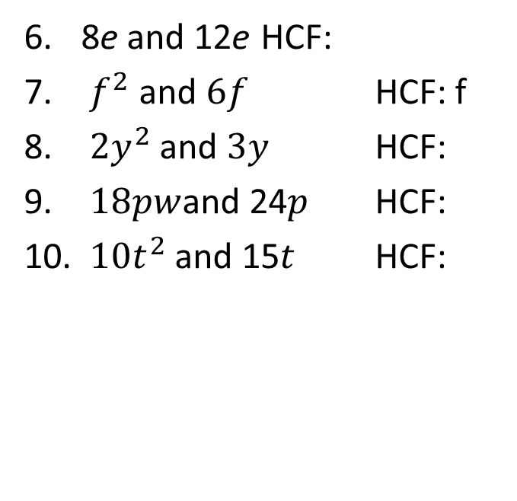
Your turn - LHS
Find the Highest Common Factor of the following?
Think: Which times tables are both terms in?
Remember: Letters can go out the front if they are in both terms
4 and 6 HCF: 2
10 and 15 HCF:
2a and 6 HCF:
21a and 28b HCF:
5. 3k and 6k HCF: 3k
8e and 12e HCF:
$f^{2}$ and $6f$ HCF: f
${2y}^{2}$ and $3y$ HCF:
$18pw$and 24$p$ HCF:
$10t^{2}$and 15$t$ HCF:

Slide 4
24
7
30
Factorising Expressions
Date
EQ – How do I factorise expressions?
What is factorising?
If expanding brackets is turning 2(a + 3) into 2a + 6, then factorising is turning 2a + 6 back into 2(a + 3)
The Highest Common Factor (HCF) of both terms is placed outside the front of the brackets.
If both terms have the same letter, that letter can be placed out
the front too.
Example: The HCF for 2a + 6 is ‘2’ so that is put out the front of
brackets like so…
2 ( ____ + _____ )
How do we use the HCF to help factorise?
From our knowledge of the Distributive Law, we know
2 ( ____ + _____ ) = 2a + 6
This means 2 x ______ = 2a and 2 x ______ = 6
So 2a + 6 is factorisied to produce
2 (__a__ + __3__)
What goes inside the brackets?

Slide 5
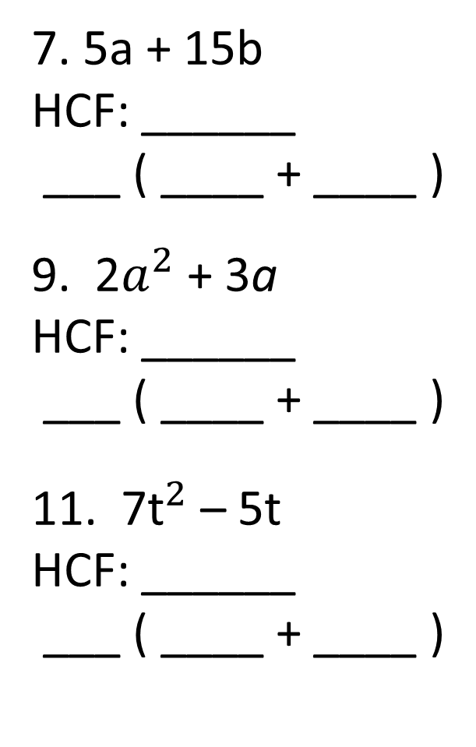
Dwyer Pg 41- 3.11 (All the odd questions)
2x + 6
HCF: ______
___ ( ____ + ____ )
3. 2c + 4
HCF: ______
___ ( ____ + ____ )
5. 3a – 6
HCF: ______
___ ( ____ + ____ )
7. 5a + 15b
HCF: ______
___ ( ____ + ____ )
9. 2$a^{2}$ + 3a
HCF: ______
___ ( ____ + ____ )
11. 7${\text{t}}^{2}$ – 5t
HCF: ______
___ ( ____ + ____ )

Slide 6


Task- Fill in the blanks
Expanding Factorising
6 (a + 8) 6a + 48
= 6 x a + 6 x 8 HCF: 6
= 6a + 48 6 x ___ = 6a & 6 x ___ = 48
= 6 ( a + 8 )

